Slide 1


Stream Control Transmission Protocol and Potential Denial-of-Service Attack
V Anil Kumar
CSIR Fourth Paradigm Institute, Bangalore
anil@csir4pi.in
Debabrata Das
International Institute of Information Technology, Bangalore
ddas@iiitb.ac.in
CSIR-4PI

Slide 2
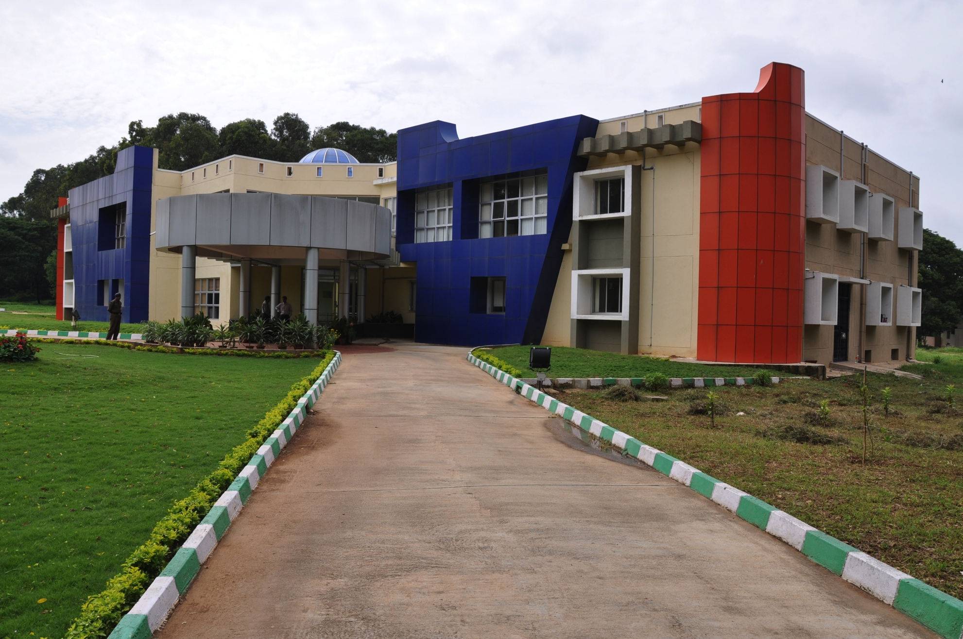
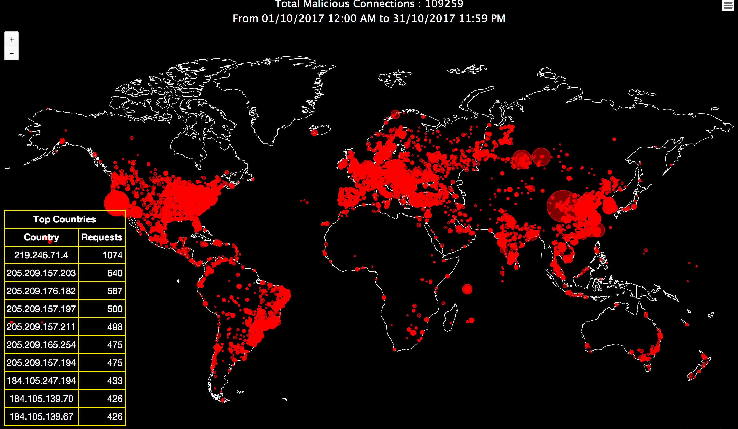
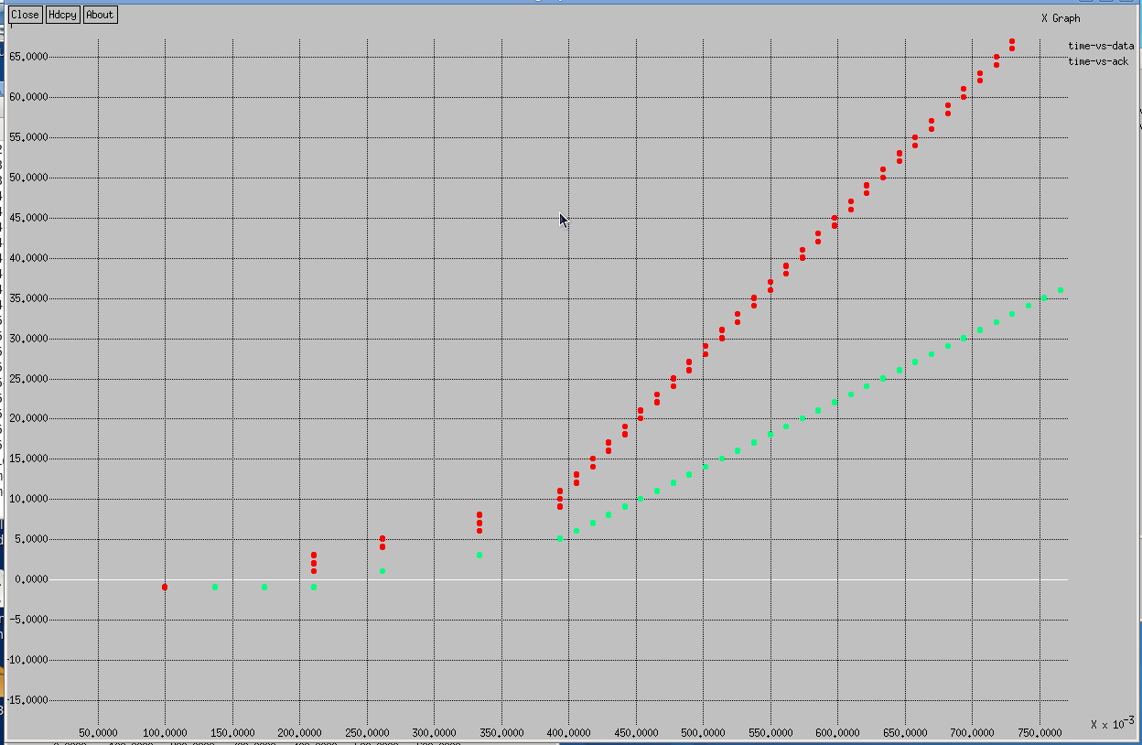
Outline
CSIR-4PI and its Cyber
Security Research
DDoS attacks: Some Trends and Observations
Mirai Botnet and the
Recent DDoS against Dyn
Feedback Loops in
Transport Protocols
Feedback Manipulation in SCTP and DoS Flood
Feedback manipulation
Attack Simulation
S1
100 Mbps 0.01ms
100Mbps 0.01ms
D1
Sender
Receiver
1Mbps 10ms
S2
R1
R2
D2
100 Mbps 0.01ms
100Mbps 0.01ms
S3
D3
Feedback Manipulation Attack Experimentations
SCTP Packet Traces during Attack
Robust Protocol Design
DESACK

Slide 3
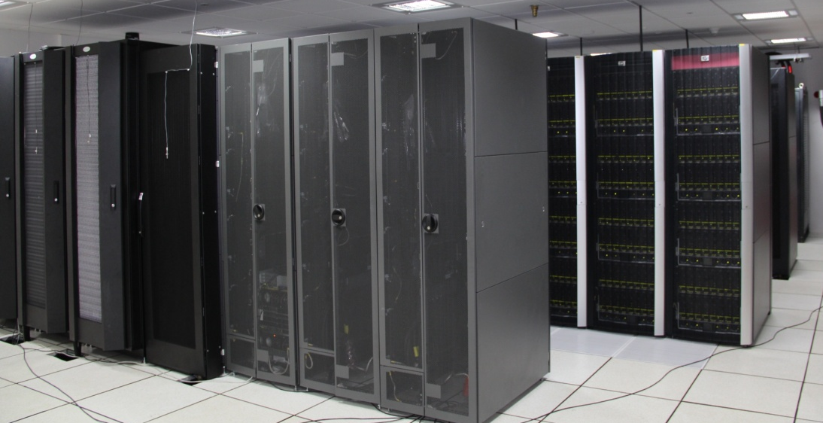
CSIR Fourth Paradigm Institute (CSIR-4PI)
Mathematical Modelling of Complex systems and data intensive research
Powered through High Performance computing (360 TF centralized supercomputer)
One of our focuses: Cyber Security Research and Observation (CySeRO)

Slide 4
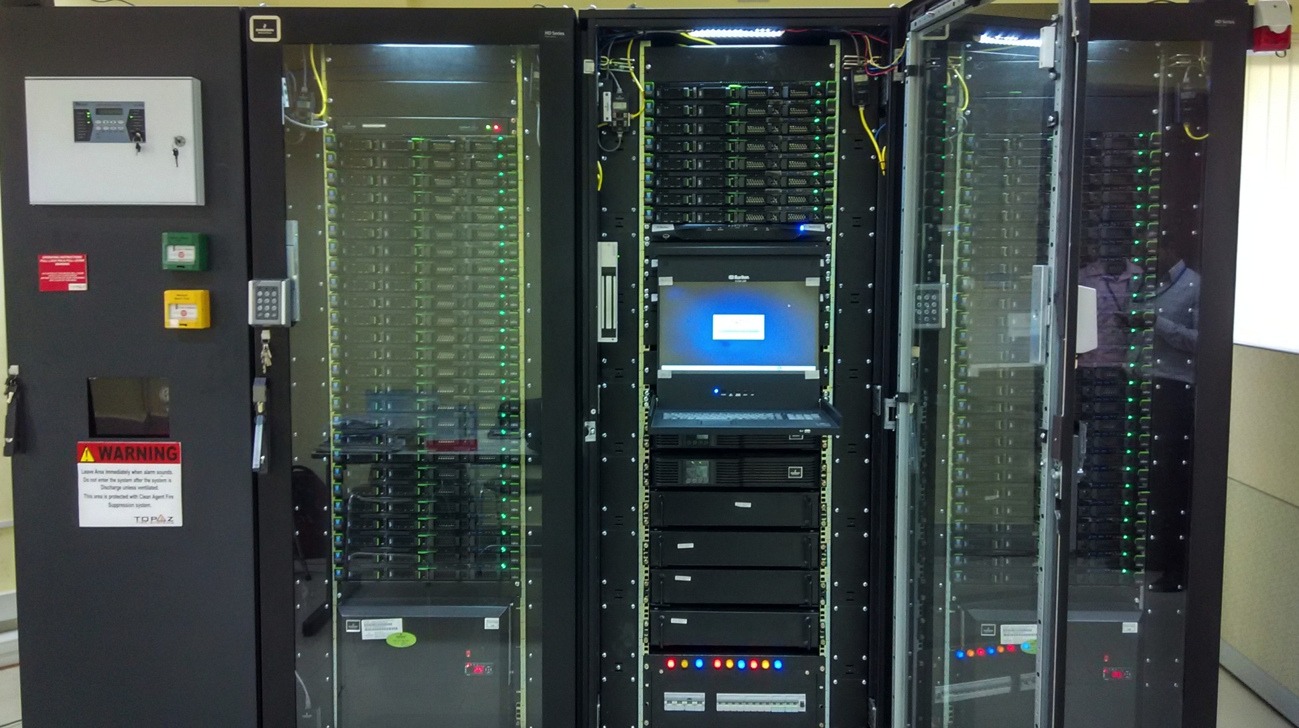
Cyber Security Research and Observation Platform @CSIR-4PI
A Programmable, Reconfigurable and Observable Test environment
Emulate wide conditions: Topology, BW, latency, Queuing Scheme;
Buffersize, Packet drop, etc
Configuration: 60 nodes; Self-contained DC (UPS; cooling; automatic door opening, CCTV, Water leakage detection etc.)

Slide 5
Flooding Denial-of-Service Attacks
Denial-of-Service attacks are arguably the biggest threat that Cyberspace has been facing
Not new to the security community
Almost as old as the Internet itself
However, they have undergone rapid and significant changes
Increase in amplitude and frequency of attacks
Sophistication in flood generation
Illusiveness to detection and mitigation techniques

Slide 6
Most Powerful DDoS Attacks
Gaining more Strength
Flood exceeded 1000 Gbps
Source: Arbor Networks and Dyn

Slide 7
A Large Scale DDoS Attack: Real Example
Mirai: One of the largest botnets ever seen:
Several thousands of compromised hosts/devices
Mainly IP cameras, home routers, IOT devices etc. running Linux
Exploited for the largest ever seen DDoS attack
Oct. 21, 2016 from 7 AM onwards
Multiple occurrence on the same day
Estimated flood rate of ~ 1.2 Tbps
DNS lookup request
Target: Dyn, an Internet and DNS infrastructure service provider
Mirai Spread was through TCP port 23, 2323 and 7547

Slide 8
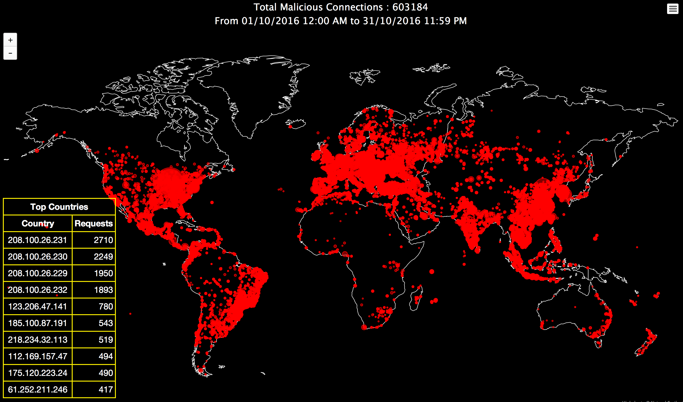
Geographical Distribution of TCP Scan (2323) Originators Observed at CSIR-4PI, Bangalore

Slide 9
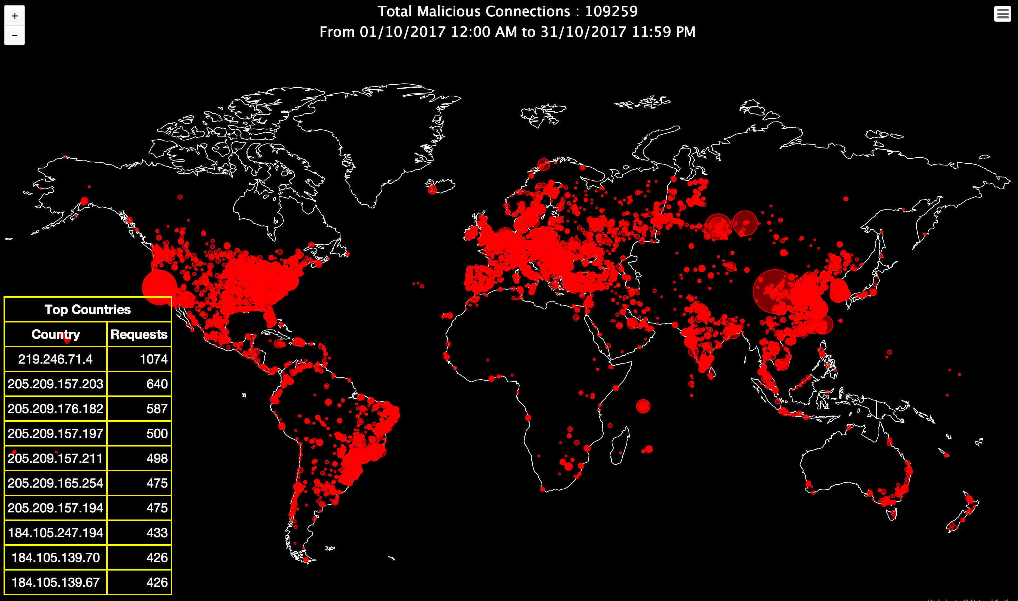
Geographical Distribution of TCP Scan (2323) Originators Observed at CSIR-4PI, Bangalore

Slide 10
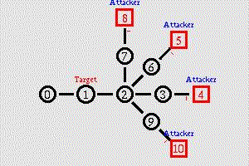
A Conventional Brute-force Flooding DDoS Attack
non-responsive
to congestion
responsive
to congestion
Very Powerful: Can virtually detach a network from the Internet !

Slide 11
Feedback Operation of Protocols on the Internet
Reliable protocols needs to operate in a closed loop feedback manner:
TCP: the well-know transport protocol on the Internet
SCTP: a new entity in transport layer
MPTCP: An innovative next generation protocol
Reliable Data transfer
Flow control
Congestion Control
Duplicate delivery
Forward Path: Data
Sender
Receiver
Reverse Path: ACK, window update, cong. notification
Internet is probably one of the biggest manmade closed-loop feedback system
We have millions of such feedback loops in every seconds
Notes:
Feedback operation of communication protocol is not a new things! However, it has not been highlighted from a security perspective.

Slide 12
Security Concern in Feedback Protocols
Feedback manipulation is a potential source of vulnerability in feedback protocol
A feedback manipulation attack takes place when the receiver manipulates the feedback with malicious intention
Typically, the manipulation (i.e the manipulated packet) does not violate the protocol standard in both syntax and semantics
Acceptable to the sender
But still can impose damage such as DoS to sender or its upstream network

Slide 13
Feedback Manipulation Attacks
Is feedback manipulation a potential vulnerability in next generation protocols ?
Can it be exploited to constitute powerful and sophisticated attack scenarios ?
How feasible are such attacks ?
What are the impacts ?
How to design protocols robust to feedback manipulation ?
Feedback Manipulation Flooding Denial-of-Service Attacks
Tactical manipulation of protocol feedback for flood generation

Slide 14
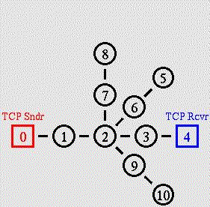
Feedback Manipulation Flooding Attack
Conventional Flooding DoS Attack
Feedback Manipulation Flooding Attack
Transport
Protocol
Attacker
A different flooding strategy than being practiced today
* Reverse flood direction; * High flood amplification; * Control on flood pattern

Slide 15
Stream Control Transmission Protocol (SCTP)
A relatively new transport protocol
Connection oriented, reliable protocol
Originated from SIGTRAN working group for transporting SS7 (telecom signaling)message over IP
Evolving as a general purpose protocol
IETF Standard – 4960 (~150 page spec)
Several unique features, not supported by TCP and UDP
Multi-homing; Multi-streaming; protection against SYN-flooding; etc.
Message oriented rather than byte oriented

Slide 16
Feedback Manipulation Flooding Attack (FMFA) on SCTP
SCTP is a feedback based protocol
Flow and congestion control are implemented at the sender side, but are strongly controlled and driven by the receiver feedback
Receiver feedback is communicated through SACK
A 32 bit advertised receiver window (a_rwnd)
A 32 bit cumulative TSN (Transmission Sequence No.) acknowledgement
TSN ACK is used for congestion control, and hence to control data transmission rate

Slide 17
End-to-end Congestion Control: A Feedback Driven Process
Each SACK that acknowledges new data (new TSN ACK):
Decrements the amount of unacknowledged data (flight_size) by the amount of data acknowledged by the TSN filed of SACK
Increments the cwnd:
cwnd = cwnd+1 (in slow-start)
cwnd = cwnd+1/cwnd (in congestion avoidance)
Sender sends out new data when cwnd > flight_size till flight_size = cwnd
Each SACK with new TSN ACK will trigger new data packet(s)
Typically one data packet in CA and two SS
cwnd=cwnd/2 upon detection of a data packet loss
cwnd can be inflated beyond the path capacity through feedback manipulation

Slide 18
Optimistic SACK Spoofing in SCTP (The basic Building Block of FMFA)

Slide 19
Simulation
We used a simple topology and ns2 for simulation
Later did extensive real-world experimentations
S1
100 Mbps 0.01ms
100Mbps 0.01ms
D1
1Mbps 10ms
S2
R1
R2
D2
100 Mbps 0.01ms
100Mbps 0.01ms
S3
D3
S1, S2 and S3: SCTP senders and D1, D2, D3: receivers
R1 and R2 Routers with FIFO and max. buffer 40 pkts
Our simulation captures three important aspects:
Fairness among flows; router buffer dynamics and cwnd dynamics
They are best suited to visualize the attack
Highlights how these parameters are pushed to their extreme cases during the attack

Slide 20
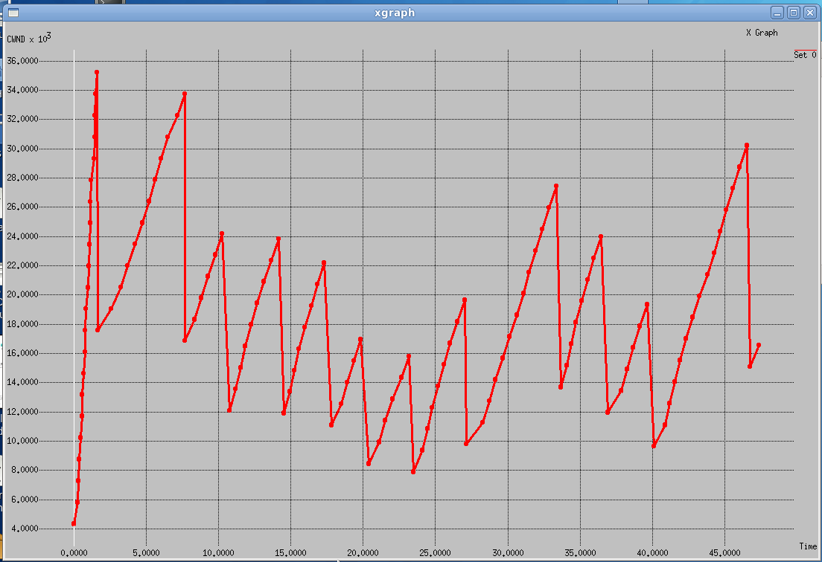
Simulation of Normal Scenario
AIMD (Additive increase multiplicative Decrease) of CWND
S1
100 Mbps 0.01ms
100Mbps 0.01ms
D1
1Mbps 10ms
S2
R1
R2
D2
100 Mbps 0.01ms
100Mbps 0.01ms
S3
D3

Slide 21
Simulation of FMFA
We repeated the previous simulation exactly with one change:
S1-D1 flow is replaced with FMFA flow

Slide 22
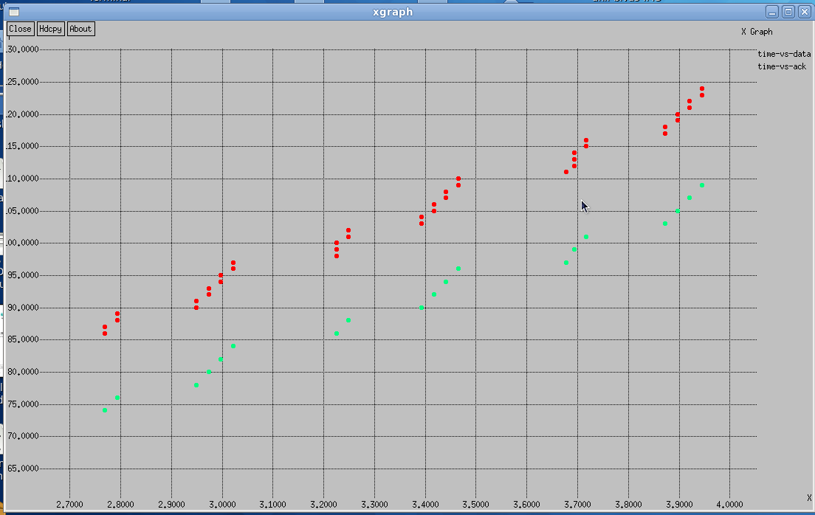
SCTP Sender’s Response to Genuine SACK (Simulation)
Data
SACK
Data and SACK Chunks
During congestion avoidance with delayed ACK
Time in seconds

Slide 23
SCTP Sender’s Response to Manipulated SACK (Simulation)
Data/Flood
SACK (Manipulated)
Data and SACK Chunks
Manipulation started here
Time in seconds

Slide 24
SCTP Exploitation: Simulated and Real-world Experimental Result
15 hops real-world
Internet Path
Experimental Topology SACK Packet Loss and its Impact on Flood-Rate

Slide 25
CWND Comparison during FMFA: Simulation vs. Experimentation
Linux Kernel: Real-world Experimentation
Ns2 Simulation
CA Algorithm
Slow-start Algorithm
CA Algorithm
Slow-start Algorithm

Slide 26
Low-rate FMFA
Can we generate shrew-like flooding pattern through Feedback manipulation ?

Slide 27
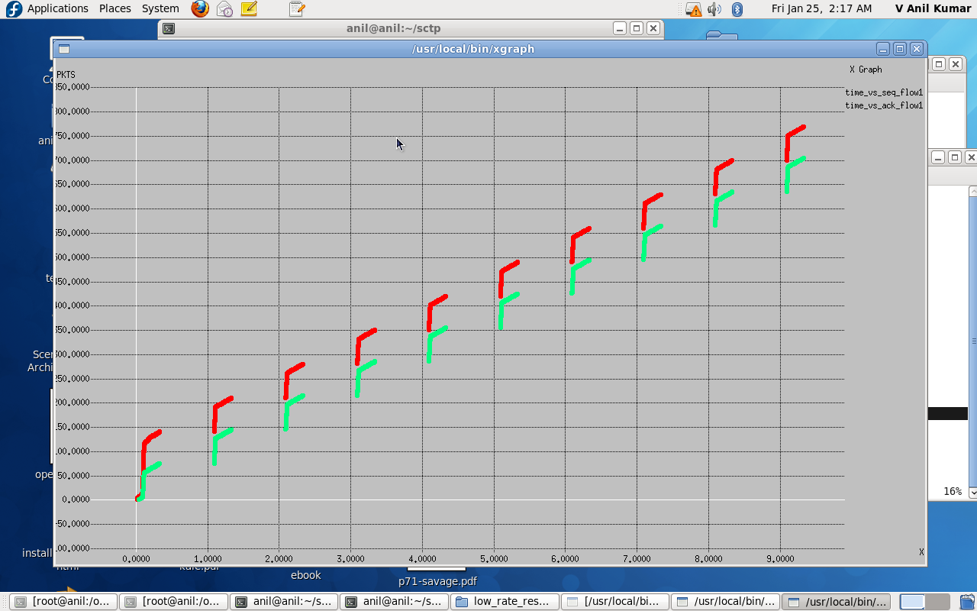
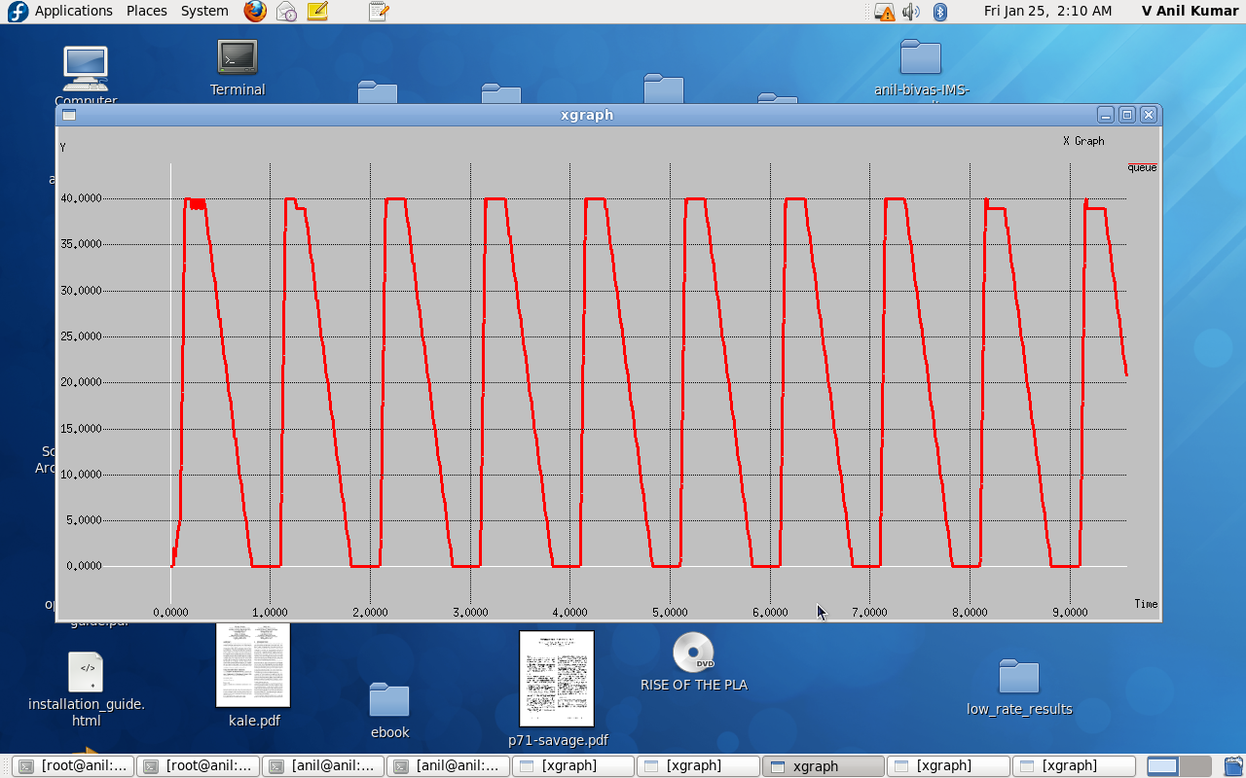
Low-rate FMFA Simulation
TSN
Data/Flood
SACK (Manipulated)
Time (s)
Pkts in Buffer
Time (s)

Slide 28
FMFA- the Root Cause
Purely Header-driven Acknowledgement: A fundamental limitation
Valid SACK can be generated without seeing/opening the data
We enriched SACK with CPE for making SCTP robust to ACK spoofing: DESACK

Slide 29
Cumulative Payload Essence (CPE)
The most crucial part of the DESACK-enabled SCTP
Designed carefully to make the protocol robust to flood generation through loss-concealment
Robust to data packet reordering, packet loss and duplicate data delivery
Essentially, a binary sum of the 32 bit essence of (PE) of all data being acknowledged through C_TSN_ACK
For a DESACK of C_TSN_A, say, X:
Where ISN = Initial Sequence No. PE[i] = Payload Essence of i^{th} packet
CPE is placed in DESACK’s V-tag field and conventional V-Tag validation is replaced with DESACK validation : Static vs. dynamic V-Tag

Slide 30
Data Enriched SACK Aware SCTP (DESACK-SCTP)
We added three new modules to regular SCTP to obtain DESACK-SCTP
*CPE Generator *DESACK Generator *DESACK Validator

Slide 31
DESACK: V-Tag Dynamics (Experimental Result)
A 60 second long experiment over the Internet with our DESACK-enabled SCTP

Slide 32
DESACK: Robustness against Data Packet Loss (Experimental Result)
A 1000 seconds (16+ minutes) long test with varying packet loss
Environment: Combination of controllable testbed and real Internet
Packet loss is introduced at the testbed and the remaining packets are released to the Internet

Slide 33
Thank You! Questions ?

